Slide 1
Predicting Term Deposit Subscription in Bank Marketing
Stetson Hatcher School of Business, Mercer University
BDA 650: Fieldwork
John, Naren & Santosh
Group 5
Dr. Wei Xiong
May 2025

Slide 2
CRISP -DM
1. Business Problem
2. Data Understanding/ Exploratory Data Analysis
3. Data Preparation/ Transformation
4. Modelling
5. Evaluation and Conclusion

Slide 3
PORTUGUESE BANK – TERM DEPOSIT
Portuguese bank faces low (11.7%) term deposit subscription rate.
Cold calling results in inefficient marketing and customer fatigue.
9 Calls to gain each subscriber

Slide 4

DOMAIN KNOWLEDGE
Domain Research: Reviewed peer-reviewed studies (e.g., University of Lisbon) focusing on socio-economic impacts on term deposit subscriptions.
Feature Engineering: Combined business knowledge with forward selection; added socio-economic factors like employment rates, consumer confidence, and Euribor rates.
Modeling Techniques: Compared Logistic Regression, Decision Trees, Neural Networks, and SVMs; Neural Networks achieved highest AUC (0.929).
Methodology: CRISP - DM

Slide 5
OBJECTIVES
Leverage predictive analytics to identify and target customers
Utilize insights from predictive analytics to improve marketing strategy and maximize return on investment

Slide 6
DATA UNDERSTANDING
# | Column | Data Type
0 | age | int64
1 | job | object
2 | marital | object
3 | education | object
4 | default | object
5 | balance | int64
6 | housing | int64
7 | loan | int64
8 | contact | object
9 | day | int64
10 | month | object
11 | duration | int64
12 | campaign | int64
13 | pdays | int64
14 | previous | int64
15 | poutcome | object
16 | y | object
UC Irvine Machine Learning Repository
Portuguese Bank Dataset
45,211 records
16 Features
8 Columns: Client Data
4 Columns: Last Contact Current Campaign
4 Columns: Previous Campaign
Multivariate
https://archive.ics.uci.edu/dataset/222/bank+marketing

Slide 7
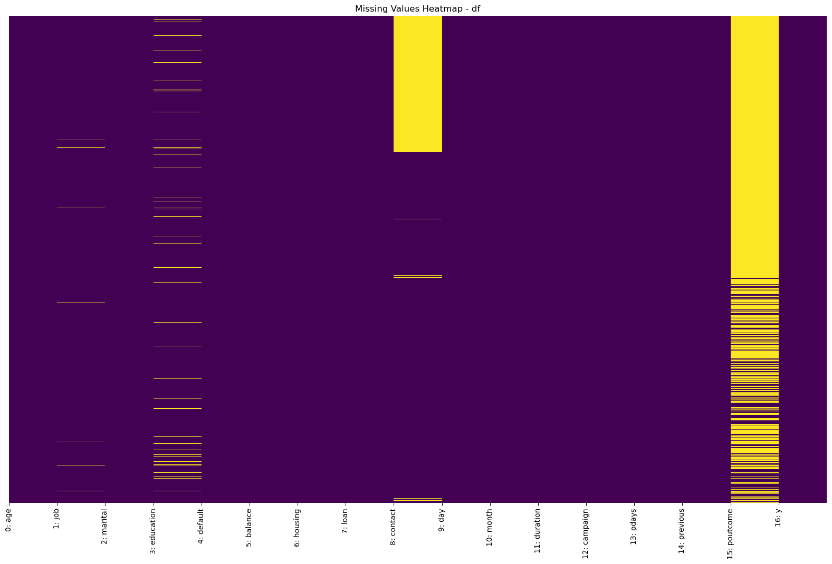
DATA CLEANING & OUTLIERS
Column | Null %
job | 0.64%
education | 4.11%
contact | 28.80%
poutcome | 81.75%
Columns Handling
Deleted previous_outcome – too many NAs
education and job - KNN Imputation
Contact - Unknown
Dropped ’Day’ - High granularity
Column | Outlier Value | Outlier %
age | 70.5 years | 1.08%
balance | 3462 Euros | 10.42%
duration | 643 Seconds | 7.16%
campaign | 6 curr_contact | 6.78%
previous | 16 prev_contact | 0.21%
Outliers Handling
‘Previous’ – Median
‘Campaign’ – Median
‘Duration’ - Median

Slide 8
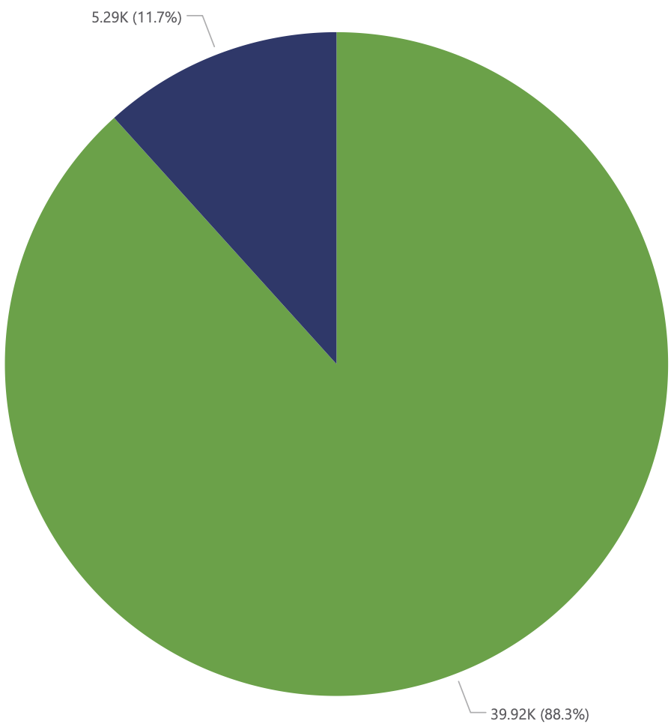
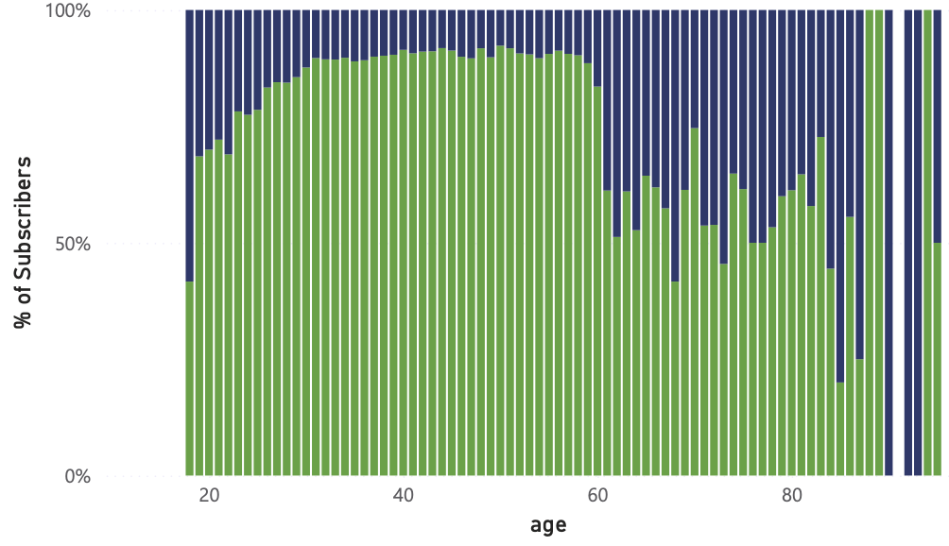
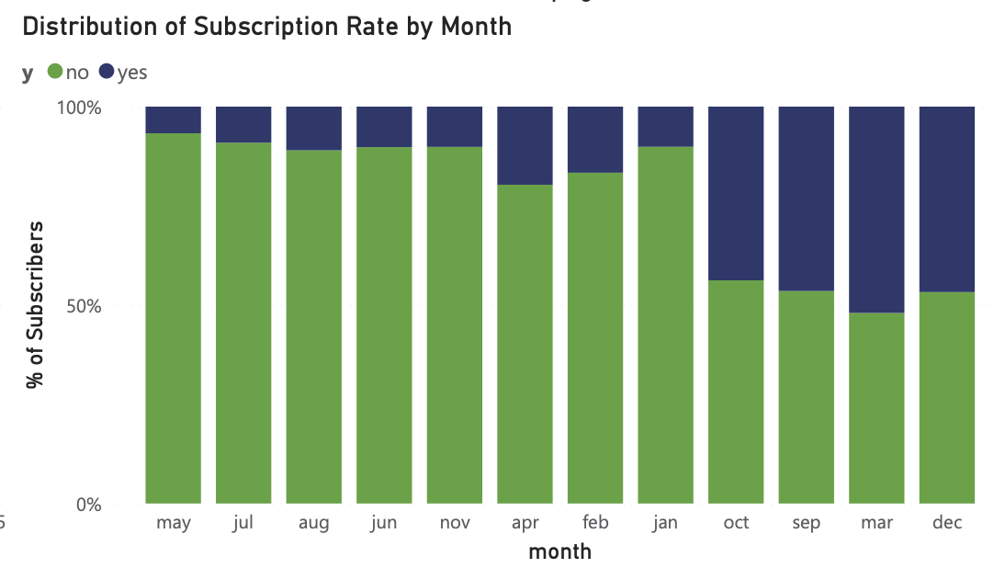

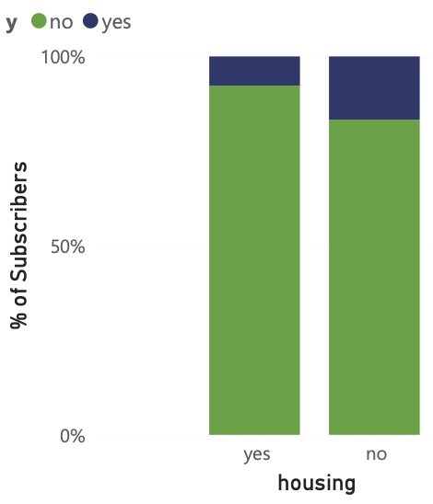
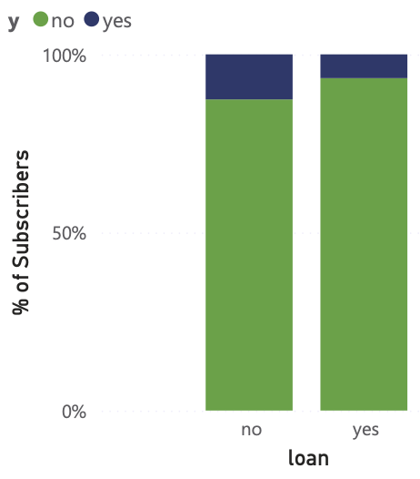
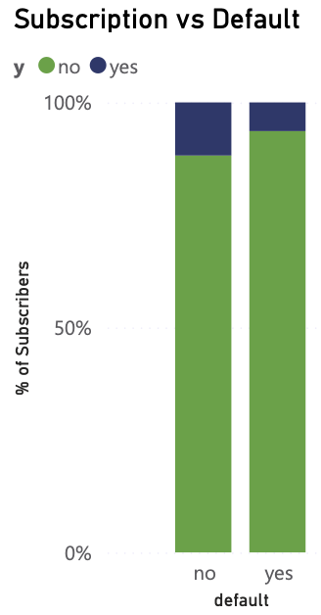
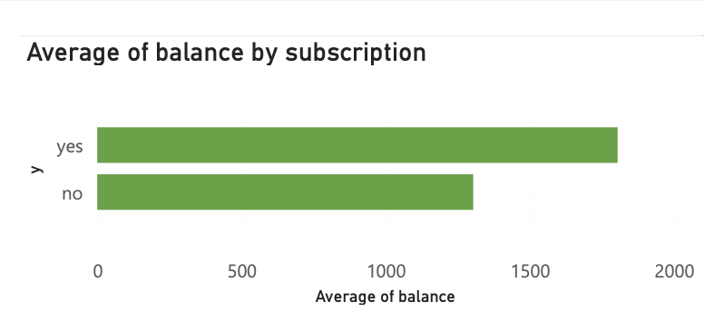
EDA - VISUALIZATION

Slide 9
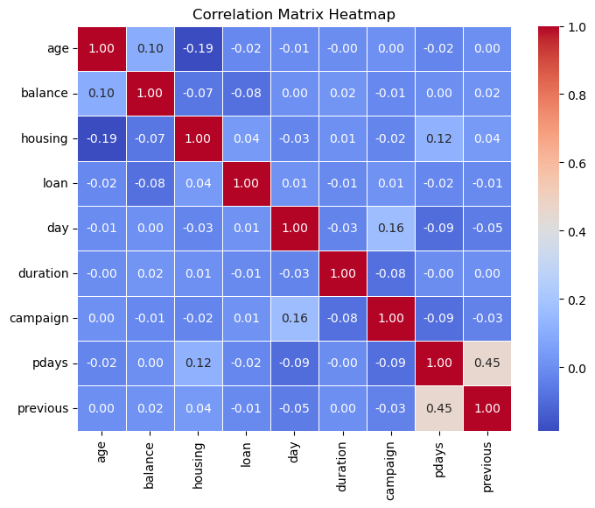


CORRELATION - HEATMAP
Look for highly correlated Variables
pdays and previous: highly correlated
Interaction term?
pdays | Number of days passed by after the client was last contacted from a previous campaign (-1 means never contacted)
previous | Number of contacts made with the client before this current campaign, including all prior interactions

Slide 10

WHY MODELLING?
develop predictive models that identify customers most likely to subscribe.
Increase subscription rates beyond the current 11.7%,
And enhance marketing efficiency
This modeling effort aims to replace mass cold calling with data-driven targeting, improving customer experience and reducing campaign costs.

Slide 11
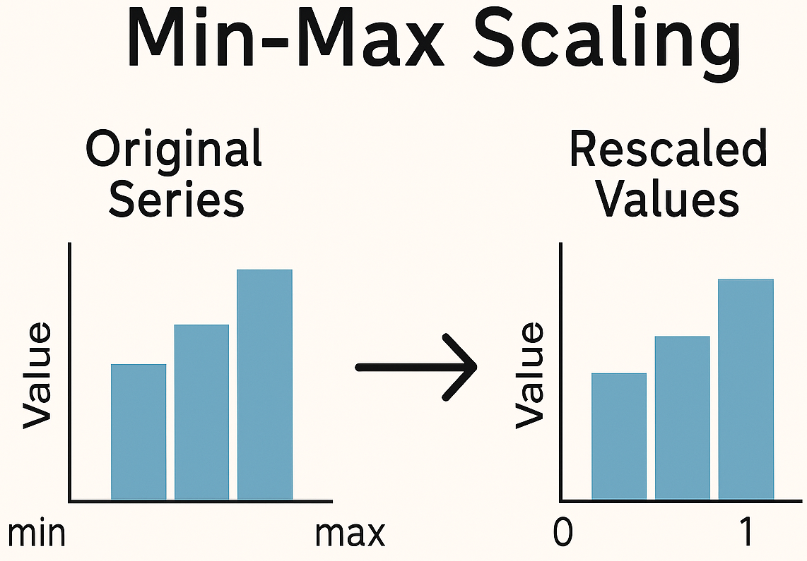
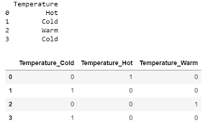
DATA TRANSFORMATION
Numerical Columns – Data Normalization
Min- Max Scaler
2. Categorical Variables
Pd. Get Dummies
New df:
(35 variables)
Export this cleaned and transformed data
READY FOR MODELLING

Slide 12
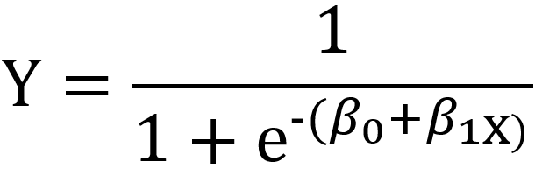
MODELLING - 1. LOGISTIC REGRESSION
Stratified Split
Train and Test (70% and 30%)
logit_model <- glm(y ~ ., data = train_data2, family = "binomial")
Top 5 Variables with highest coefficients
Cut off point: 0.2
 | Reference no | Reference yes
Prediction no | 10,814 | 556
Prediction yes | 1,138 | 1,026
Variable | Coefficient | p-value | Significance
duration | 20.26178 | < 2e-16 | 0.001
previous_pdays_interaction | 3.78728 | < 2e-16 | 0.001
contactcellular | 1.80986 | < 2e-16 | 0.001
contacttelephone | 1.72365 | < 2e-16 | 0.001
monthmar | 1.73169 | < 2e-16 | 0.001
Sensitivity = 64.85% (5.5x better than baseline)
Specificity = 90.47%
Accuracy = 87.48%
No Information Rate/ Baseline = 88.3 %
Area under the curve: 0.8895

Slide 13
2. RANDOM FOREST
 | Reference no | Reference yes
Prediction no | 10,650 | 403
Prediction yes | 1,302 | 1,179
Cut off point: 0.22
Feature | no | yes | MeanDecreaseAccuracy | MeanDecreaseGini
duration | 52.8601276 | 86.888975 | 85.8074664 | 1941.7284
housing | 26.2806398 | 20.503937 | 34.8640701 | 188.39321
month | 30.5203608 | 17.0952675 | 32.9912795 | 665.06003
previous_pdays_interaction | 21.6330531 | 25.635425 | 27.8608753 | 469.76915
contact | 22.6649353 | 9.9032561 | 24.2748041 | 166.97965
Sensitivity = 74.52% (6.4x better than baseline)
Specificity = 89.1%
Accuracy = 87.4 %
No Information Rate/ Baseline =. 88.3 %
Area under the curve: 0.9122

Slide 14
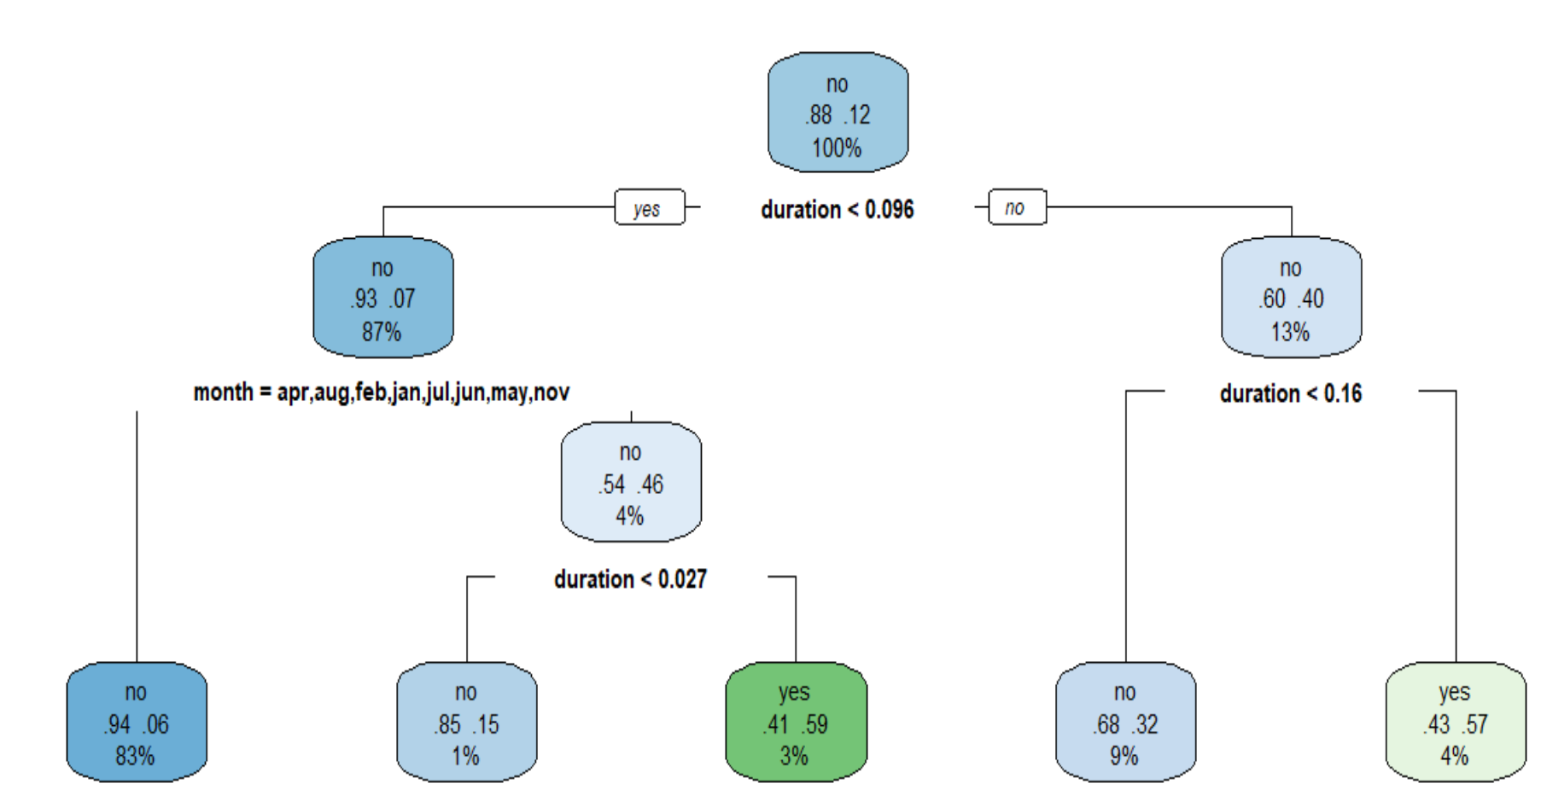
3. Decision Tree
 | Reference no | Reference yes
Prediction no | 10,716 | 657
Prediction yes | 1,236 | 925
Sensitivity = 58.4% (5x better than baseline)
Specificity = 89.6%
Accuracy = 86 %
No Information Rate/ Baseline =. 88.3 %
Node | Split Condition *(denotes terminal node) | n | Loss | yval | yprob (no, yes)
1 | root | 31582 | 3693 | no | (0.88306630, 0.11693370)
2 | duration < 0.09607564 | 27467 | 2029 | no | (0.92612954, 0.07387046)
4 | month = apr, aug, feb, jan, jul, jun, may, nov * | 26240 | 1469 | no | (0.94401677, 0.05598323)
Cut off point: 0.2
AUC for Decision Tree: 0.75

Slide 15
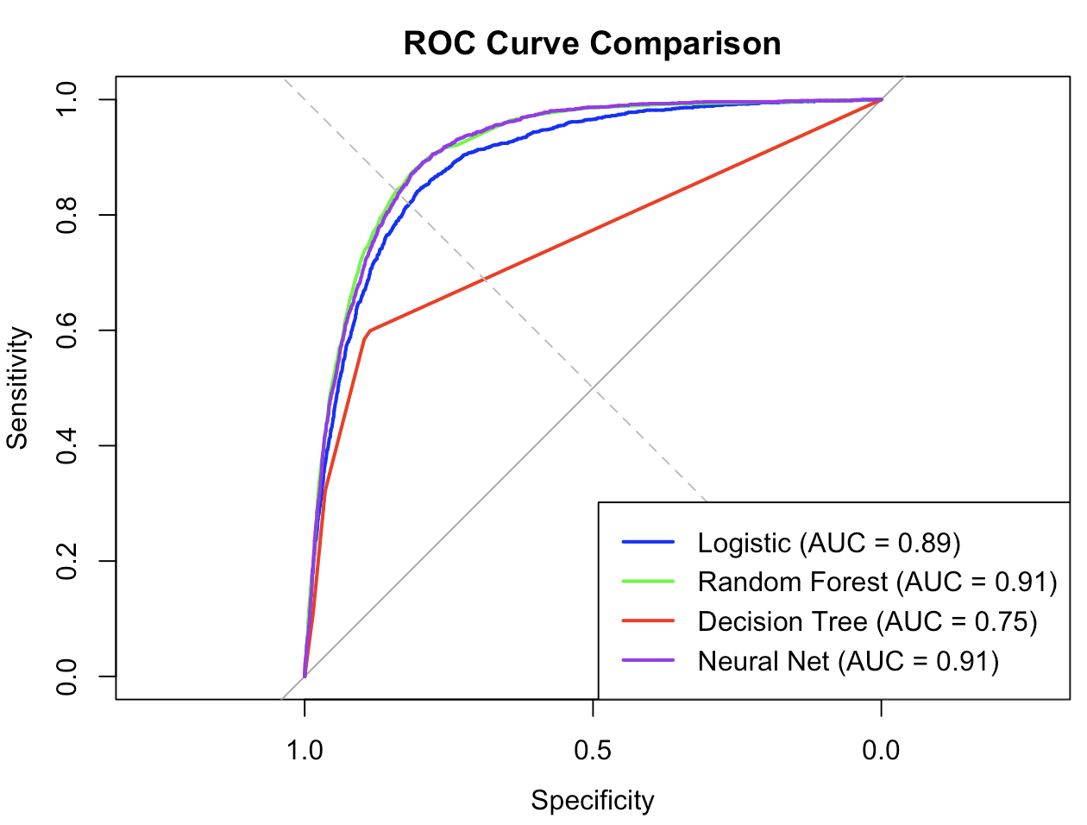
4. Neural Network vs All other models
Sensitivity = 74.27% (6.3x better than baseline)
Specificity = 88.5%
Accuracy = 86.88 %
No Information Rate/ Baseline = 88.3 %
 | Reference no | Reference yes
Prediction no | 10,583 | 407
Prediction yes | 1,369 | 1,175
0.25 Cut off Point
AUC for Neural Network: 0.91

Slide 16
EVALUATION- BENEFIT ANALYSIS
Metric (Test Data) | Without Model (Random Calling) | With Model (Predictive Targeting)
Total Customers Contacted | 13,563 | 2,481
Subscriptions Gained | 1,587 | 1,179
Success Rate (Conversion %) | 11.70% | 47.52%
Customers Contacted per Subscriber | 9 | 2
Subscribers Missed (Not Contacted) | 0 | 408
Non-subscribers Contacted | 11,976 | 1,302
Marketing Efficiency Ratio (subs/non-subs contacted) | 13% | 91%

Slide 17
THANK YOU
Any Questions?

